Slide 1
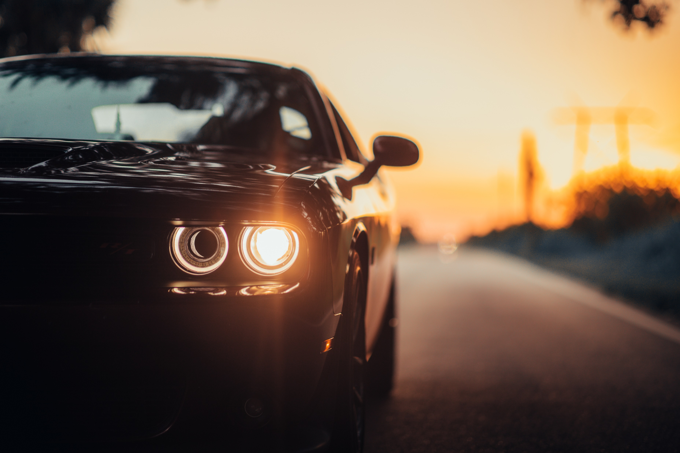
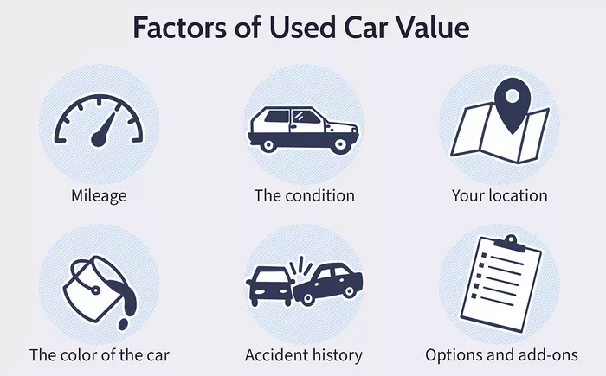
Automatic Vehicle Pricing
Barrett Patterson
Get an instant quote for what your vehicle is worth!
https://github.com/Barrettcp11/Automatic-Vehicle-Pricing

